Slide 1
Artificial intelligence – COMP 6065 FINAL PROJECT
Mineral classifier
Michael fernanlie – 1901530133
steven muliamin – 1901499280

Slide 2
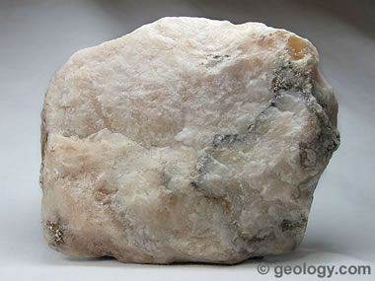
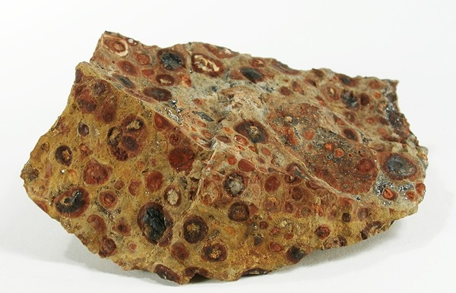
Minerals classifier
Classifying minerals.

Slide 3
Minerals classifier – tools and strategy
Docker
TensorFlow
Fatkun
Transfer Learning
CNN
Inception

Slide 4

DOCKER
Container platform
Provide a Linux or Windows VM for both MacOS and Windows

Slide 5

TensorFlow
An open source software library for various tasks, one of them including machine learning applications like neural network
By Google

Slide 6
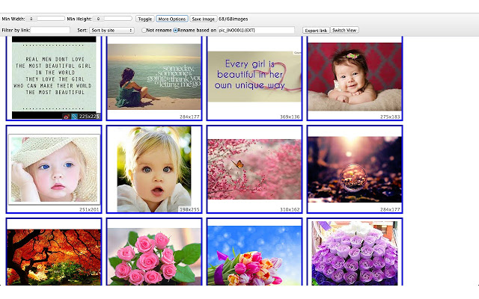
fatkun
Chrome Extension to download images from google search page
Our dataset is from google image search
However, we still filter all the images that we are about to download to ensure of correct dataset

Slide 7
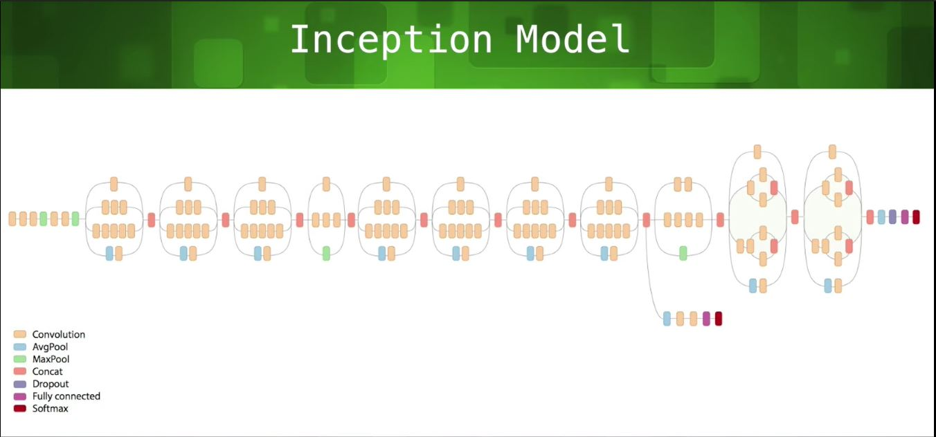
Inception

Slide 8
Inception -> Transfer learning
Edge Detection
Shape Detection

Slide 9
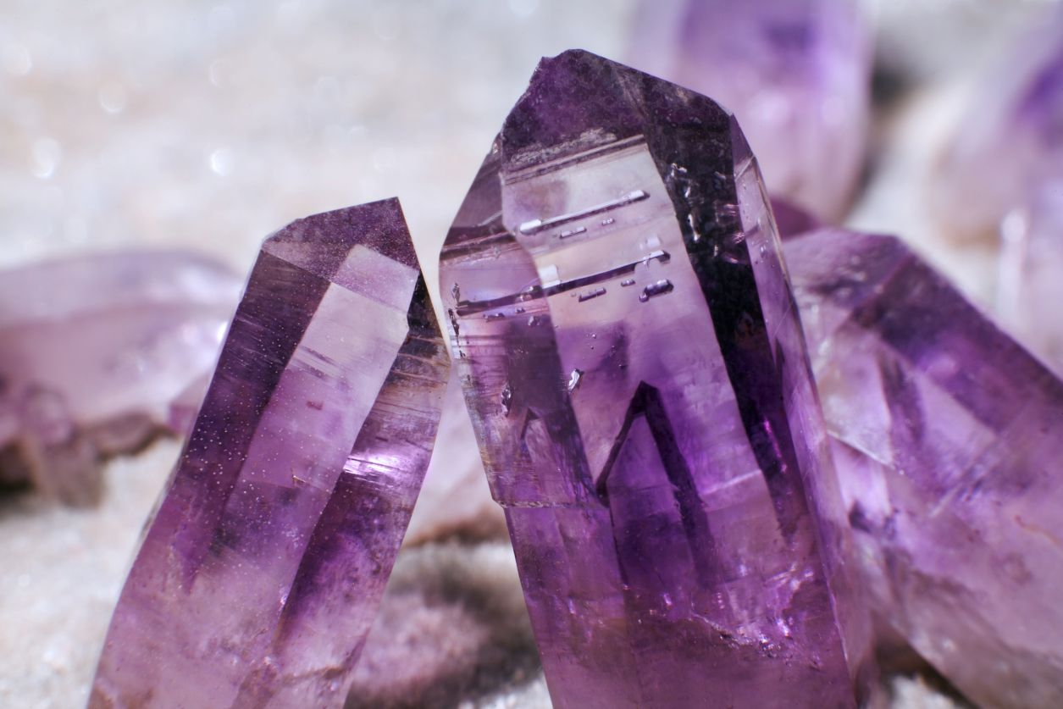
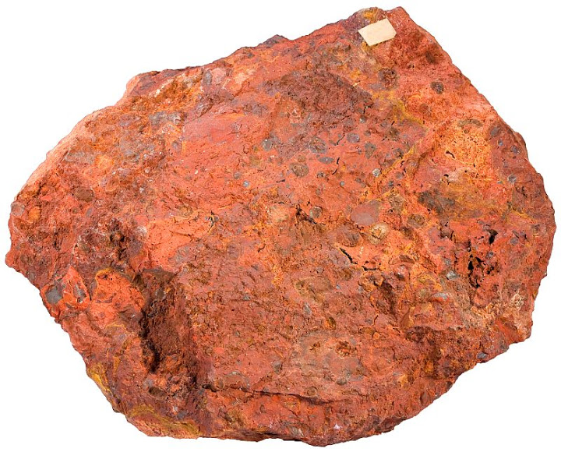
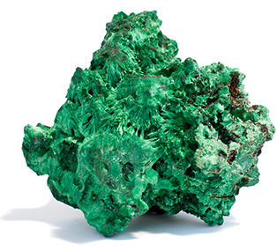
Project details – dataset
Amethyst Gypsum Bauxite Malachite

Slide 10
Project details - dataset
For each label (Amethyst, Gypsum, Bauxite, and Malachite):
100 images for training
10 images for testing

Slide 11
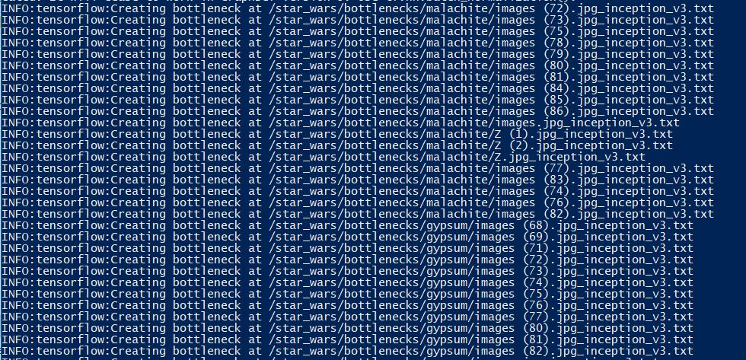
Example of running code – training 1

Slide 12
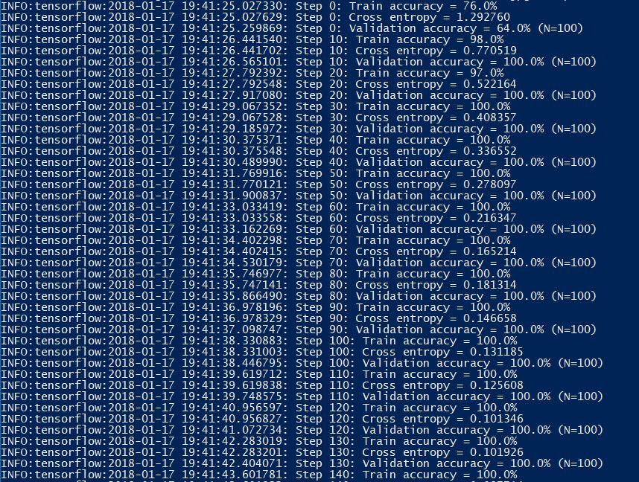
Example of running code – training 2

Slide 13
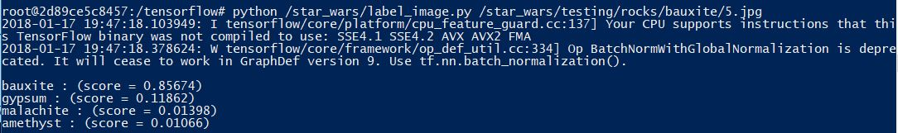
Example of running code - testing

Slide 14
Testing phase
Training Dataset | Accuracy
100% | 95.02%
70% | 91.65%
40% | 87.64%
20% | 81.72%
For training dataset, 100% is
400 images, 100 images for each
Label.
For Test Dataset, always 40 images.
10 images for each label.

Slide 15
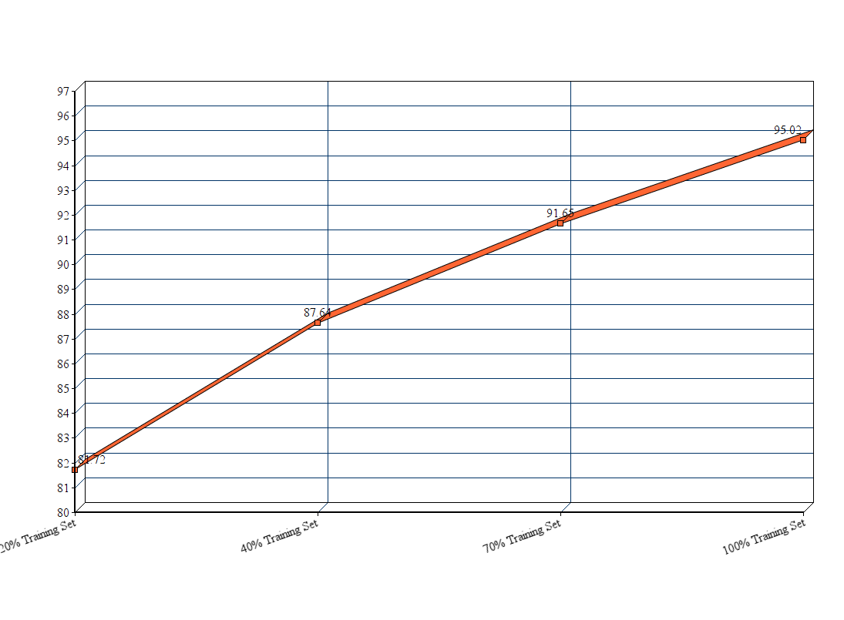
Test results graph

Slide 16
Testing phase – Category Accuracy
Minerals Type | Accuracy
Bauxite | 94.45%
Gypsum | 93.21%
Amethyst | 95.63%
Malachite | 96.42%
The accuracy of each category as
shown on the table on the left is done on
100% training dataset.

Slide 17

Thank you

